Slide 1

Engineering Student Placements
Group 4
Members:
Akif Eltahir
Regina Enrile
Connor Farrell
Mohamed Metwalli
Nicole Young

Slide 2

Goals
Reason For Selecting This Topic
Build a Machine Learning model to predict whether a person will be selected for an internship based on several factors.
Students are in the beginning of their career and it is a challenging time for them to gain the experience needed to put them in the workforce. Understanding the data available from career services in colleges and universities will help these organizations in supporting the students to land in their dream job. Our success in developing such a model will enhance student experience and provide each one with the right guidance to start a career of their choice.

Slide 3
Description Of Tools Used to Create Final Dashboard (Regina)

Slide 4
Description of Interactive Elements

Slide 5
Data Source
The data was sourced from Kaggle from an Engineering Placement dataset which features the following relevant factors:
Age
Gender
Field of Study
Past Internships
Cumulative Grade Point Average (CGPA)
Dwelling Provided
History of Backlogs

Slide 6
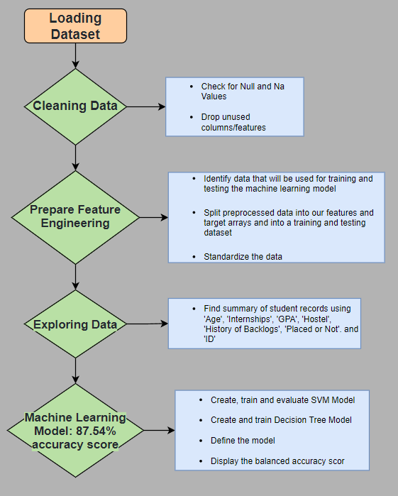
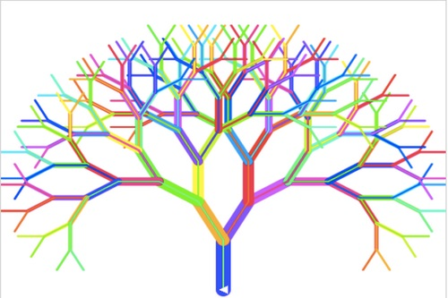
Machine Learning Model
Machine Learning Model Type: Classification model
Utilizing the features mentioned from the dataset, we are going to train a classification model - a subcategory of Supervised Machine Learning – to determine the likelihood of acceptance for future applicants. The following are the steps we will take for data preprocessing.

Slide 7
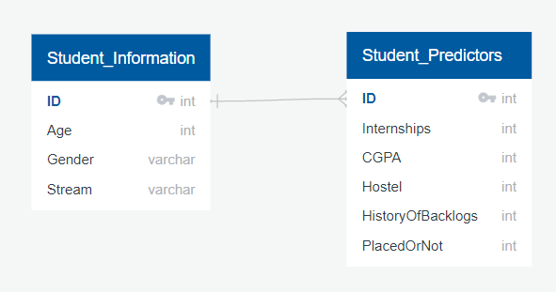
Database Integration
Create data tables using PostgresSQL
Join Tables: Student_Information & Student_Predictors (see ERD below)
Database Host: AWS RDS Service
Database Server: capstone-project

